Slide 1
Sprint #0 Ending Presentation
Look ‘N Cook
Notes:
Alex

Slide 2
Sprint #0 Goals
Our main goal is to complete our Business Requirement Document and Management Plan Document with all the necessary information that is asked such as:
User stories
User Personas
Charts(Burn Down, Project Tracker, etc.)
Notes:
Alex

Slide 3

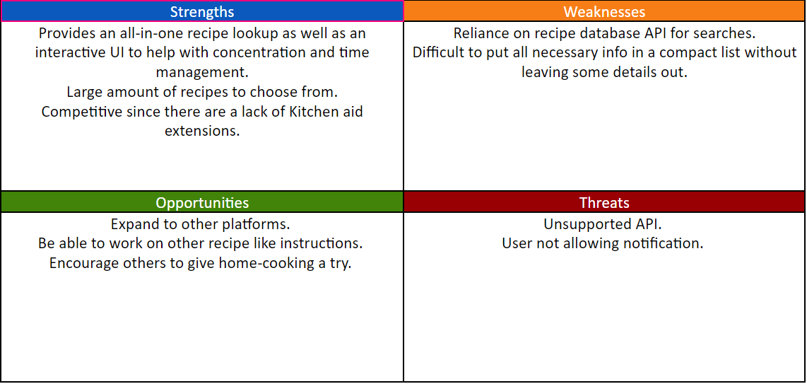
Strategy
What are we trying to solve
Problem: Finding food recipes are difficult with so many search results. Even after finding a website, there are a ton of filler text resulting in a lot of wasted time.
Solution: Create an application that searches recipes through a recipe database and allows easy navigation through the recipe instructions
SWOT Analysis
Notes:
Alex

Slide 4
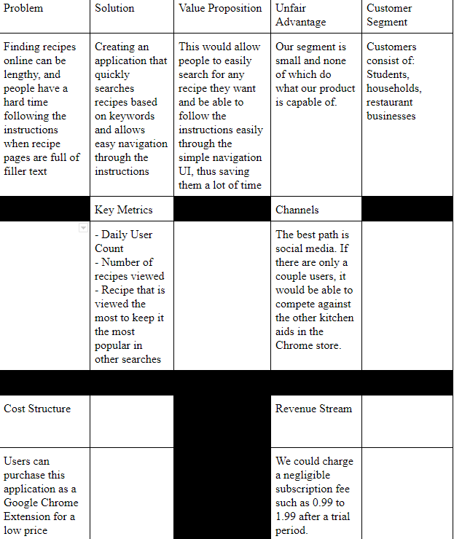
Strategy
Notes:
John

Slide 5
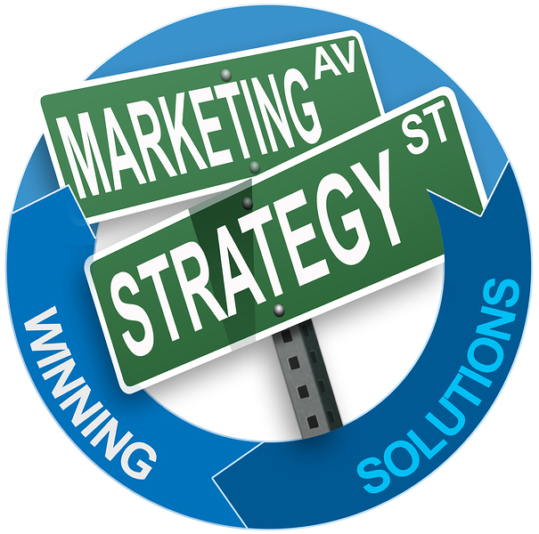
Market Segment
Our main target audience for this product is directed towards students.
Our target pool is about 19.9 Million Students in the United States Alone
Results from our own survey shows that 55/66(~90%) respond that they cook at least one meal at home.
Additional Target: General Population
According to a survey done by the Food Network 82% of meals are prepared at home a significant increase from years previous (2017)
Ratings from other extensions that are currently on the market show that they tend to go for extensions that save recipes and have a simple design
Notes:
Jose

Slide 6


Market Competition
Supercook:
Is an online website that allows you to enter the ingredients you have and will give you a recipe that require said ingredients
3 Millions users in 234 countries (2015)
Market could expand to 30 million users
Pinterest
Gives quick simple recipes
Variety of things you can find through their program
77.4 million users (2018)
Notes:
Jose

Slide 7
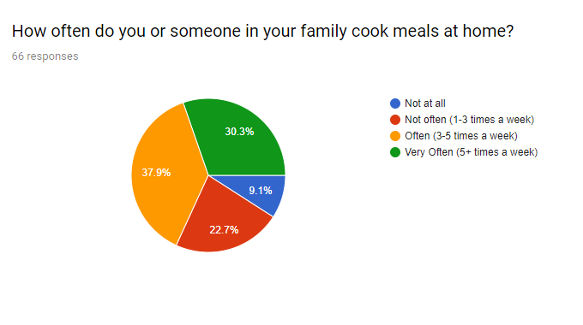

Market Research - Primary
Our Method: Google Form
Notes:
henry

Slide 8
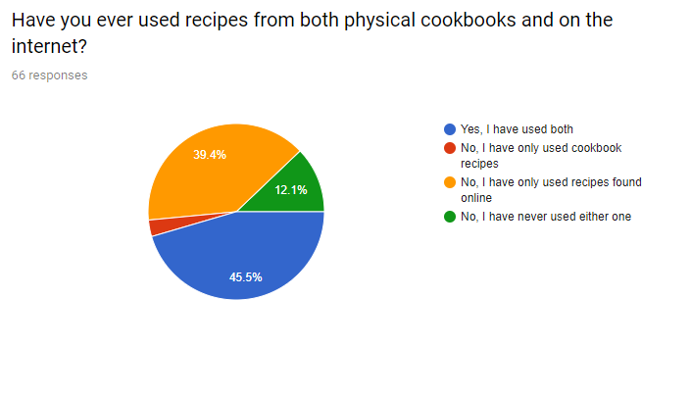
In addition, we asked users their preference between having a physical recipe from a cookbook vs. online internet recipes
Common Feedback - Physical:
Book, mainly due to pop ups, distractions and unclear/buried directions from internet recipes
Easier to use without worrying about device switching off
Common Feedback - Internet:
Wide range of variety compared to a cookbook
Easier and faster to access
Convenience
Notes:
henry

Slide 9

What sort of functionalities does our users expect from us?
Most Common Feedback:
Easy to use and simplicity
A saved list of recipes by the user
Friendly UI to guide the user
Visuals
Calorie count
Notes:
henry

Slide 10

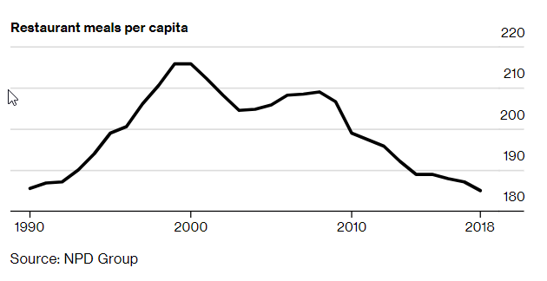
Market Research - Secondary
Are people still cooking at home, or are they eating out?
Research by NPD Group Inc., an American Market Research company, showed that 82% of Americans prepared meals at home rather than eating out
Amount of restaurant meals has been decreasing over the years
Factors:
Healthier food choices
Need of saving money
Commonly seen with Millennials
Notes:
Dane

Slide 11
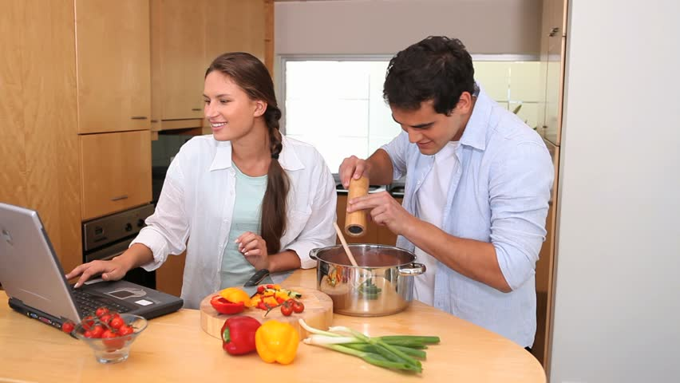
Market Research - Secondary
What do people use to help aid them in cooking?
Research through McGarryBowen and Kraft Foods showed that 59% of 25 to 34 year olds cook with a electronic device with them
Similar to the trend of people cooking at home, this is seen more with Millennials
Factors:
Easy to search for a recipe when they do not know what to make
Easy access to online resources such as Youtube videos to cook more efficiently
Can easily Google any clarifications from recipe instructions
Notes:
Dane

Slide 12
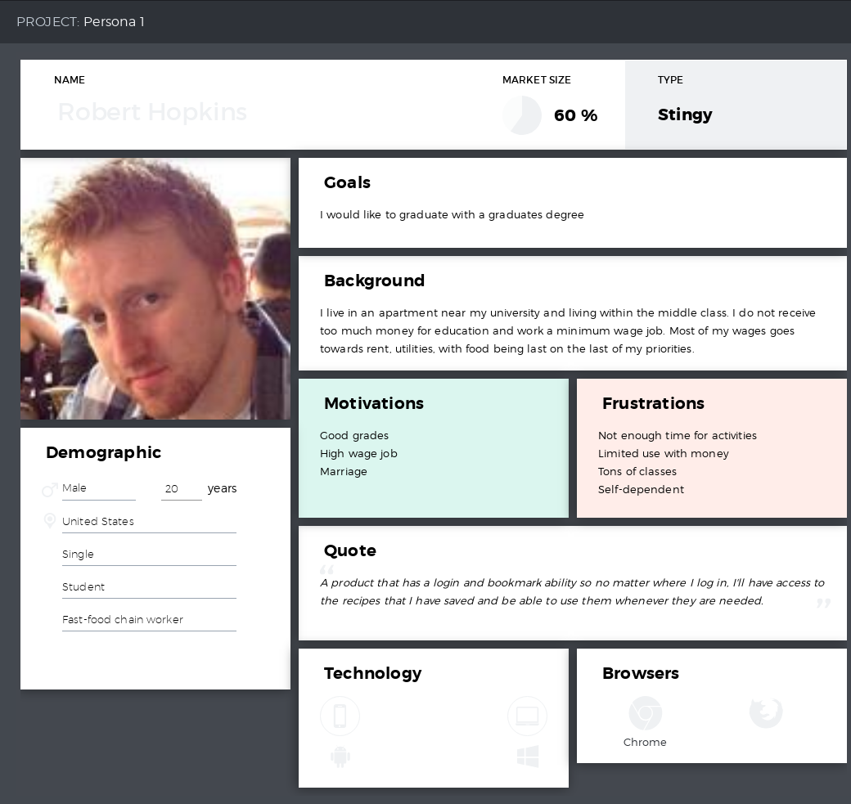
Personas
Persona 1 - Robert Hopkins
College Student
Minimum Wage Job
Main targeted market audience
Based on our findings from market research
Notes:
Dane

Slide 13
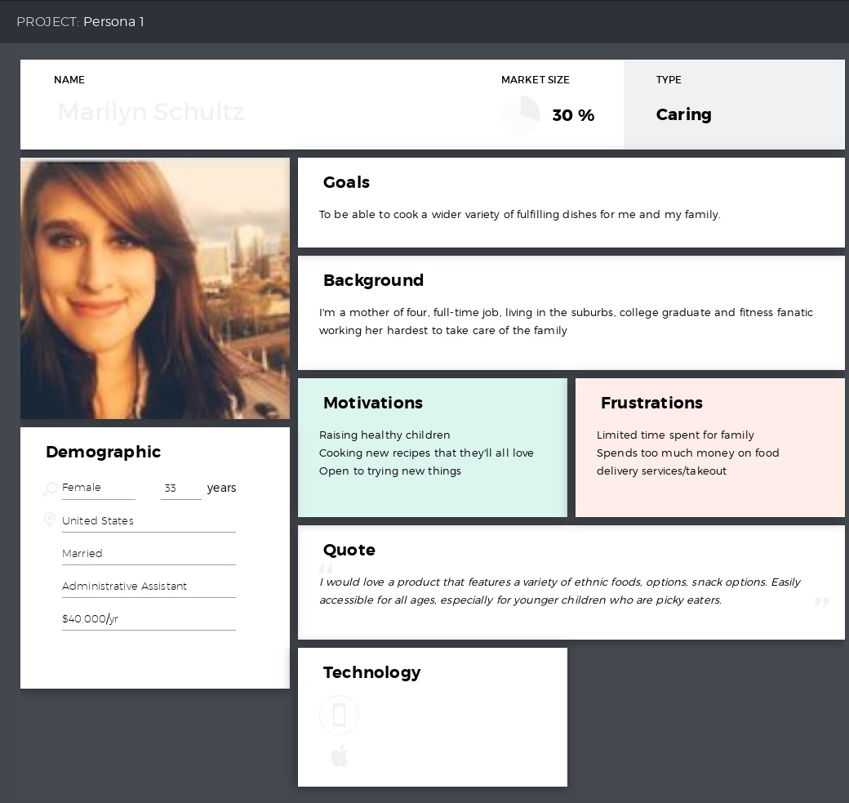
Personas
Persona 2 - Marilyn Schultz
Mother of four
Full-time job
Wants to cook healthier foods for children
Notes:
Dane

Slide 14
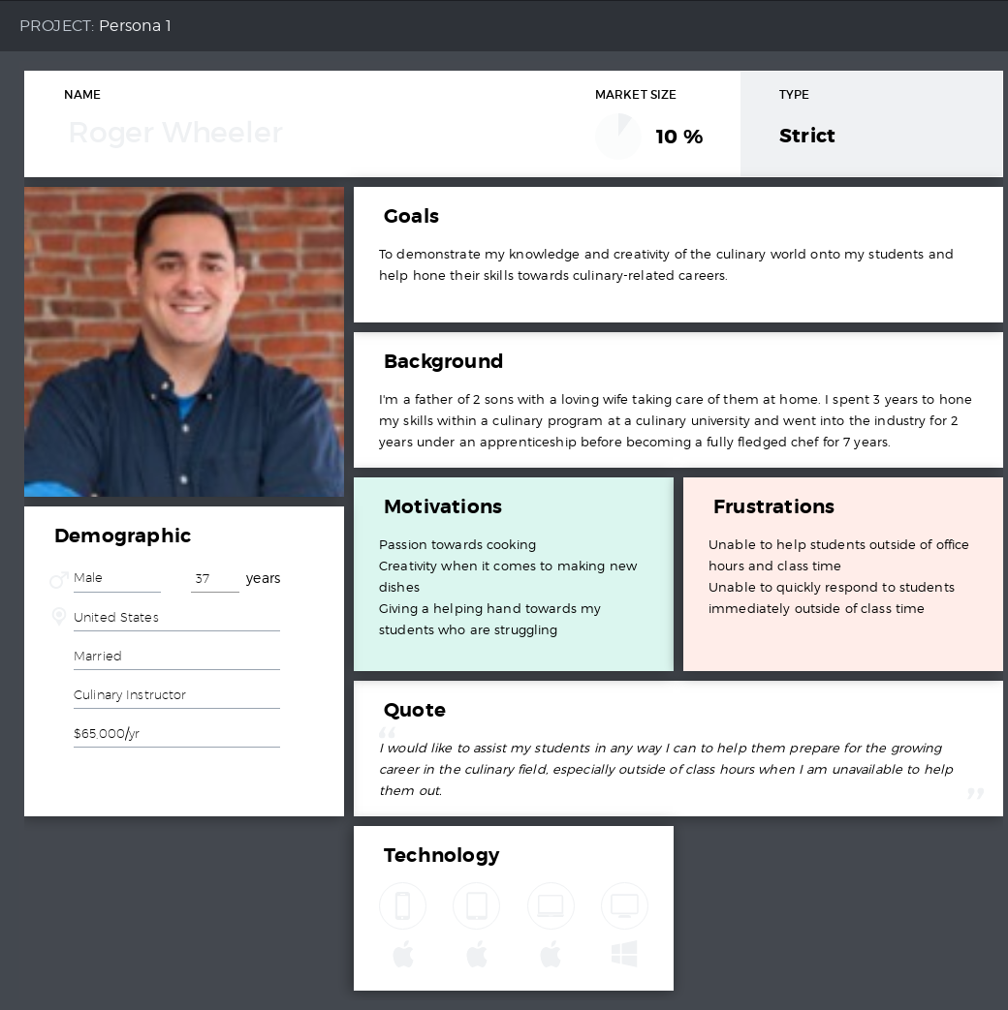
Personas
Persona 3 - Roger Wheeler
Studied in culinary and became a chef
Passion towards food and helping his Students wherever possible
Unable to reliably help them outside of Class hours
Notes:
Dane

Slide 15
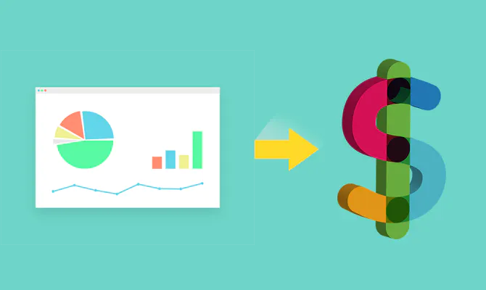
Commercialization and Monetization
Commercialization
Within the sprint we finalized our desired methods of monetization and commercialization involving social media ads, targeted clientele being culinary schools, and promoting through schools to students.
Monetization
A couple business models we decided on were:
Selling culinary schools license to use our software to push their own curriculum outside of their facilities.
Offering a subscription fee after a free trial with discounts targeted toward students.
Offering a free version with limited features/(Possibly non obtrusive banner ads)
Notes:
John

Slide 16
User Story Creation and Prioritization
Out of 68 responses to our survey we found that 85% of people used a recipe that they found online. We found our app would appeal to a broad audience.
We also asked for some use cases from those we surveyed and received very useful user stories.
Examples:
“As a user I would like to see a drop down menu of different cultural foods, for example, Mexican, Indian, Italian so that I can find foods by type”
“As a user I would like to see choices on types of meals you can make with certain appliances! (i.e. ONLY microwave, blender, stovetop, etc) so I can determine what I can make with what I have”
“As a user I would like to see the recipe software include total calorie intake for said recipe as well as cooking time so I can plan around my nutrition requirements accordingly”
Notes:
John

Slide 17
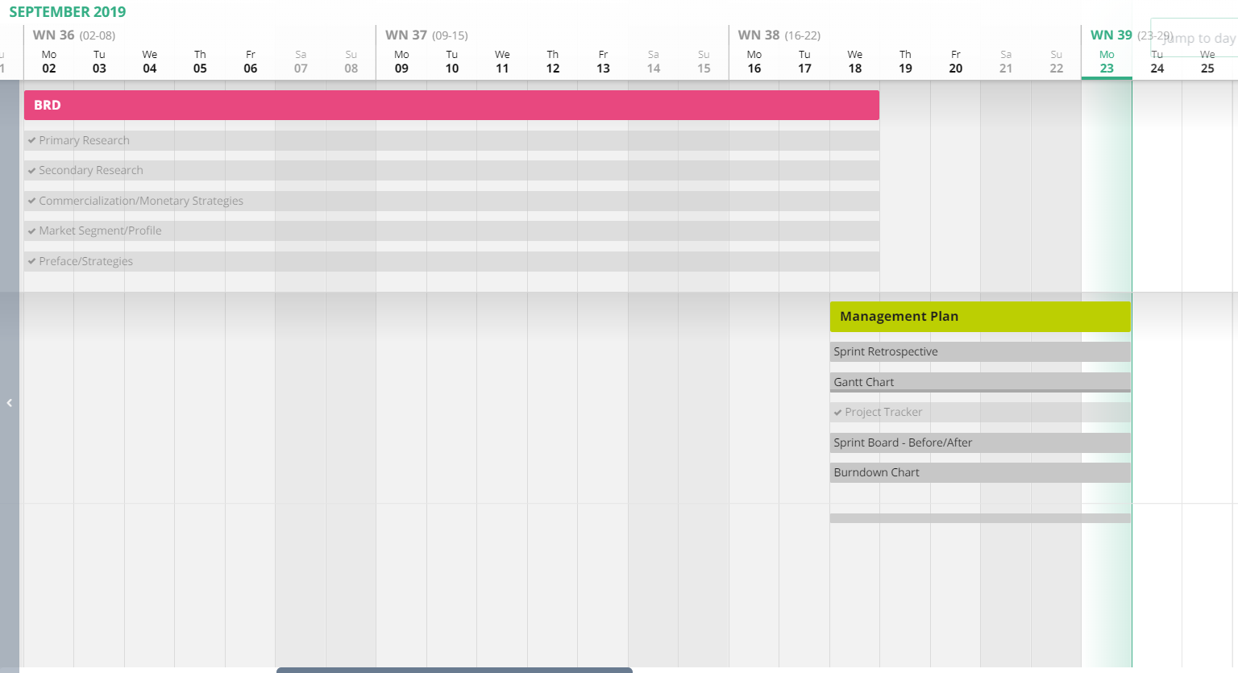
Management Plan
Gantt Chart
Notes:
henry

Slide 18
Management Plan
Task Management Velocity
Projected that Sprint #0 would take about 30 hours total to finish
Each task on average would take around 2-3 hours
Actual total time spent was about 28 hours
Notes:
Dane

Slide 19
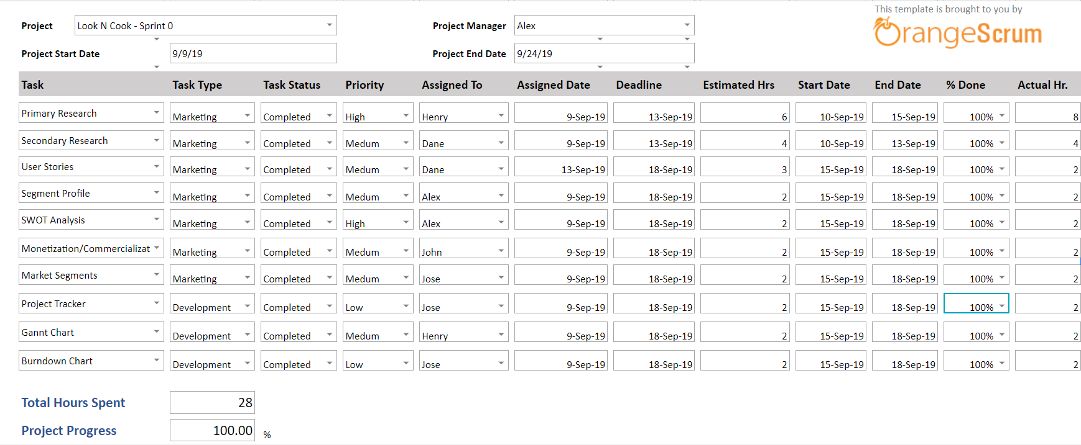
Management Plan
Project Tracker Planner
Notes:
Jose

Slide 20
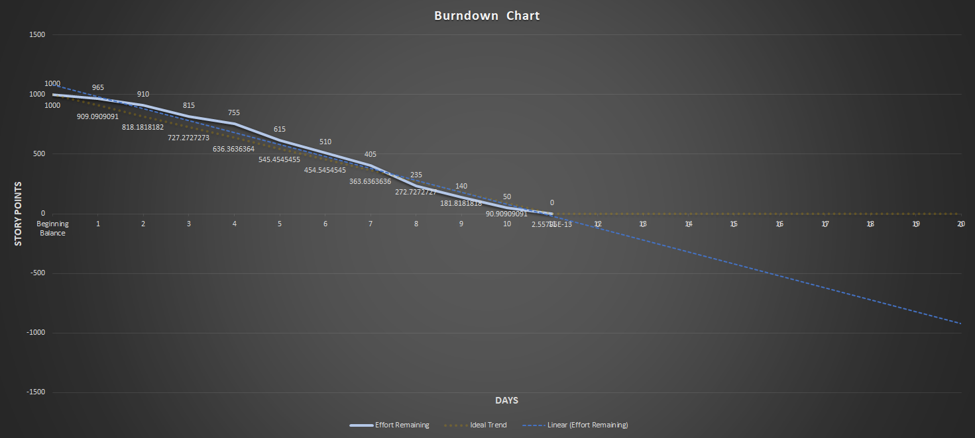
Management Plan
Burndown Chart
Notes:
Jose

Slide 21
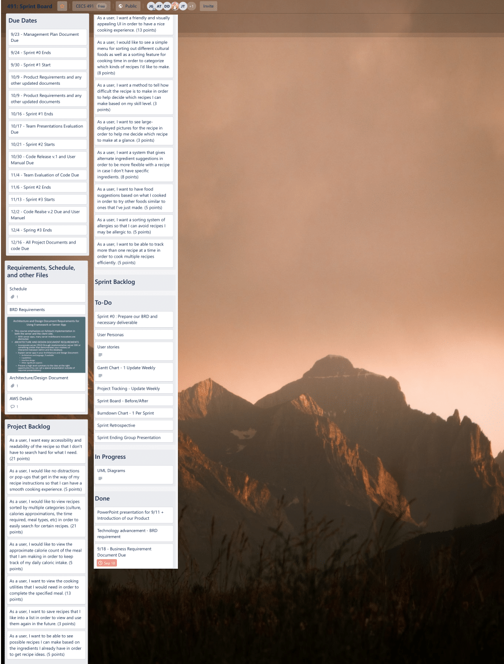
Management Plan
Sprint Board (Before)
Notes:
john

Slide 22
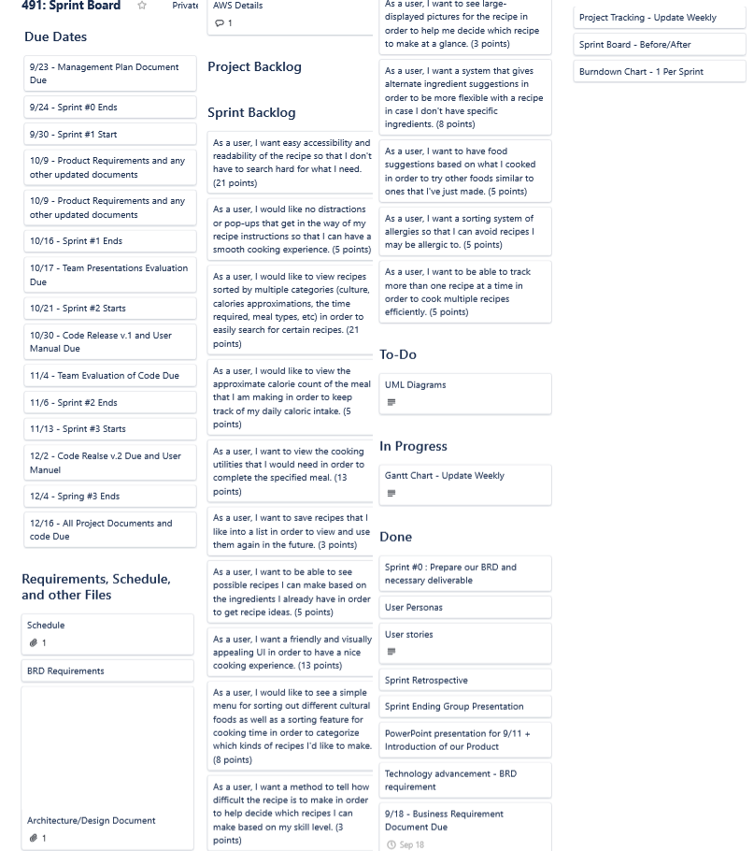
Management Plan
Sprint Board(After)
Notes:
john

Slide 23
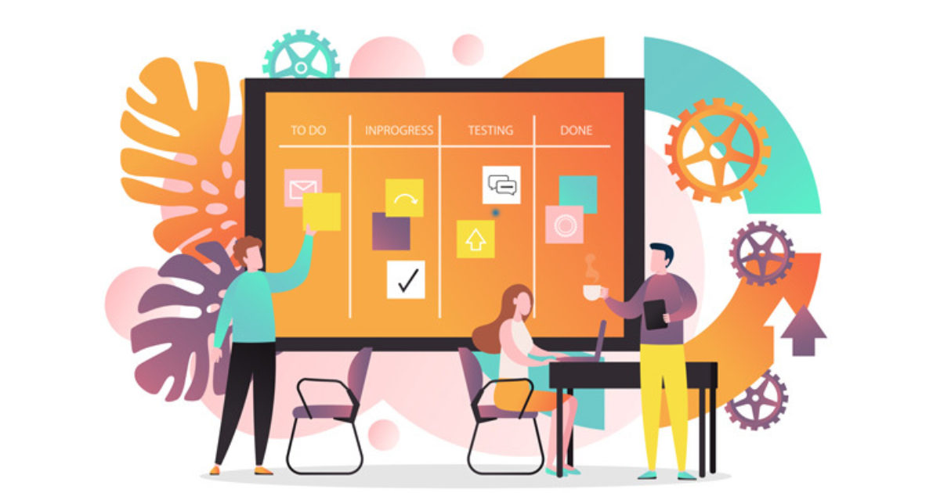
Team Metrics
Importance of Metrics: to measure our progress with time and learn the agile development process
Current Progress
Risk
Team Velocity
Tasks Burning Down
Notes:
henry

Slide 24
Sprint #0 End - What took more time than expected?
User Stories
Reasoning?
Primary Research Duration - Branching Out
In need of a variety of feedback
Unpredictable user feedback
Would we run into a similar situation in the future? → Yes
Notes:
Alex

Slide 25
Sprint Retrospective
Q1. Did we meet our Sprint Goal?
Yes, we collaborated and got most of our deliverables done on time with many tasks completed. Only the UML diagrams remains incomplete
Q2. What was the team’s velocity?
One hour per deliverable/documents per weekday → 75 hours combined effort
Q3. How does the Sprint Burndown look?
Recap: Linear workflow of our deliverables/tasks being done
Notes:
Alex

Slide 26

Plans for the next sprint
Finish any assigned documentation
Such as the Architecture and Design Documentation
Product Requirements
Start learning necessary coding languages
Start planning the incorporation of Machine Learning
Update turned in documents to reflect any changes made throughout the sprint
BRD and Management plan
Notes:
Alex

